Slide 2
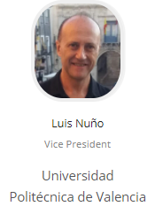
CH08402 – SPAIN Section Chapter, EMC27 2020-21

Slide 3
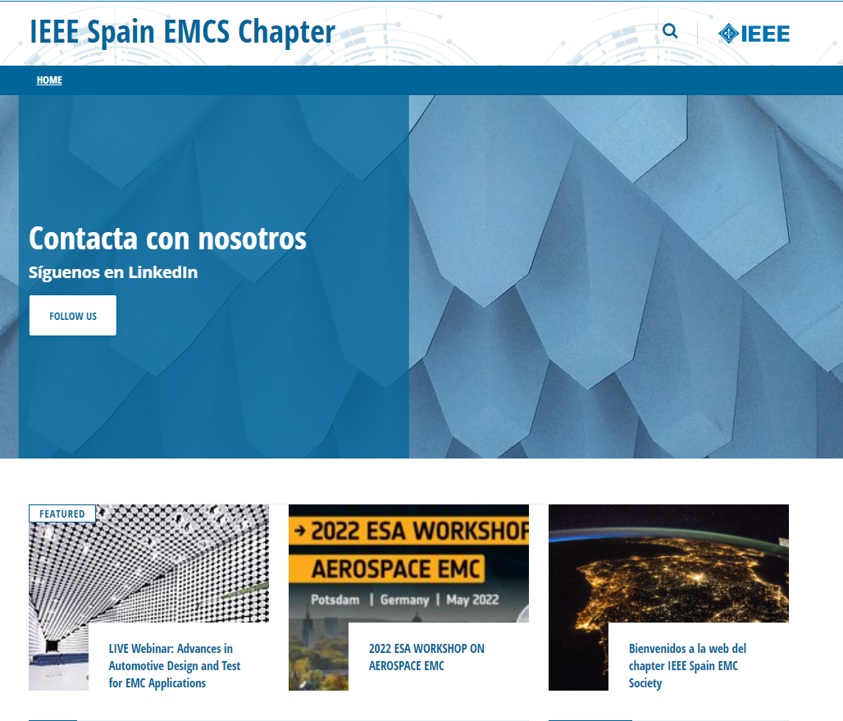
CH08402 – SPAIN Section Chapter, EMC27 2020-21
MEETINGS: Working with virtual meetings because the COVID-19 situation. The meetings were very effective while enjoying a cup of coffee reviewing the plans for our Chapter. Last meeting dated March 19th, 2021.
WEB PAGE: Our web page
was created.
First version May 2021.
You can reach it at:
https://r8.ieee.org/spain-emcs/

Slide 4
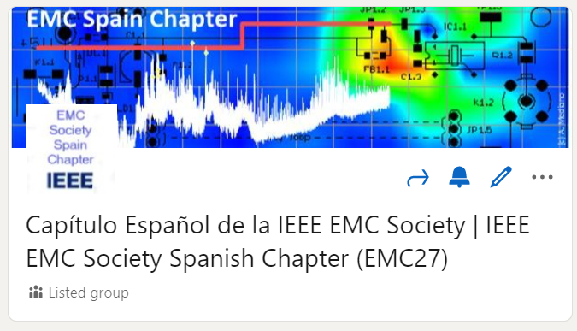
CH08402 – SPAIN Section Chapter, EMC27 2020-21
LINKEDIN GROUP: On March 2021 we created a group for our IEEE EMC Society Spanish Chapter (EMC27). This is the link for the group:
https://www.linkedin.com/groups/9043327/
In a few days we had more than 100 members. Today we have 141 members!.
We are confident that this group will be an effective communication way for IEEE EMC-S members and non-members from academy and industry. Hopefully many of the non-members will switch to be members soon.

Slide 5
CH08402 – SPAIN Section Chapter, EMC27 2020-21
CO-SPONSORED EVENTS (all included in VTools):
April 22th, we co-sponsored a LIVE webinar: “ADVANCES IN AUTOMOTIVE DESIGN AND TEST FOR EMC APPLICATIONS” were the latest information on design strategies and test methods impacting the future of the automotive industry were presented.
June 10th: we co-sponsored the “MARATHON EMC 2021 Binational Edition Part 4: #Poland – #Spain” with the Poland EMC Chapter
June 18th: we co-sponsored a LIVE session: “EMC FOR FIXED INSTALLATIONS AND DRONES FOR EMC MEASUREMENTS” organized by the Center for Industrial Electronics and the Danish IEEE EMC Society Chapter. Our Chapter was co-sponsor.
July 28th: we co-sponsored a LIVE session: “LA MAGIA DEL DISEÑO ELECTRÓNICO ATENDIENDO A EMI/EMC” organized by the IEEE Electron Devices Society Honduras Chapter and the Universidad Nacional Autónoma de Honduras. Our Chapter was co-sponsor and the Chair (Arturo Mediano) was the speaker for that conference.

